Slide 1
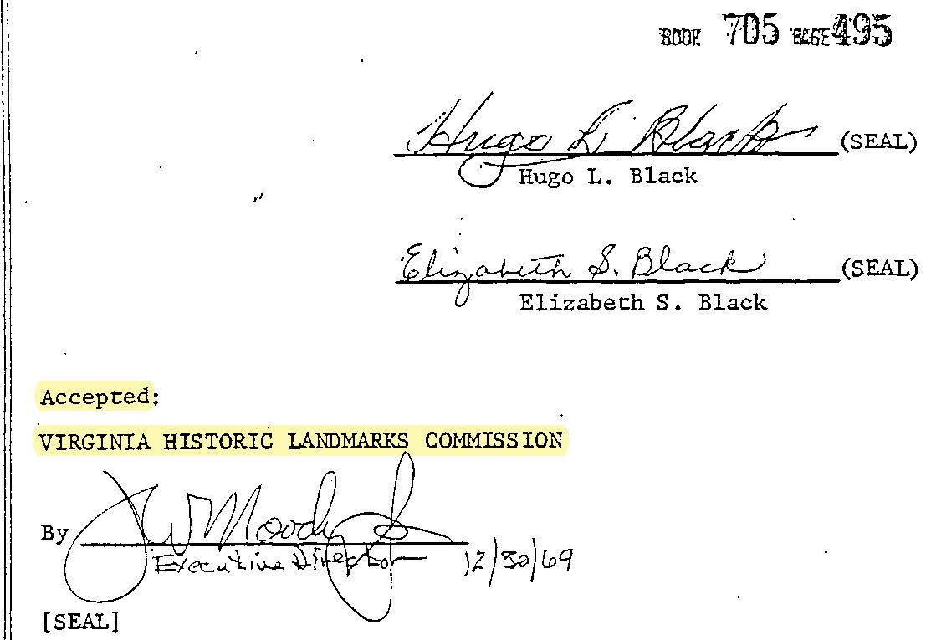
Certification of Property as Landmark of “Statewide or National Significance”

Slide 2
According to the Virginia Department of Historic Resources, 619 South Lee Street is not
individually listed on the Virginia Landmarks Register and, even if it were, that designation affords no special consideration for BAR review. While the BAR encourages that properties be listed on the both the National Register of Historic Places and the Virginia Landmarks Register, and there are 54 Alexandria buildings and sites that are presently listed on these registers, these are honorific designations that have no regulatory bearing on the criteria and standards listed in the Zoning Ordinance that the BAR must consider in acting on the appropriateness of demolition, new construction or alterations to any property in the historic district.
Staff Report at 5 (emphasis added).
B. For the purposes of this chapter, designation by the Board of Historic Resources shall mean an act of official recognition designed (i) to educate the public to the significance of the designated resource and (ii) to encourage local governments and property owners to take the designated property's historic, architectural, archaeological, and cultural significance into account in their planning, the local government comprehensive plan, and their decision making. Such designation, itself, shall not regulate the action of local governments or property owners with regard to the designated property.
Va. Code Ann. § 10.1-2204 (emphasis added).

Slide 3
10-101 - Purpose.
The City of Alexandria seeks, through the establishment of the Old and Historic Alexandria District, to protect community health and safety, to promote the education, prosperity and general welfare of the public through the identification, preservation, and enhancement of buildings, structures, landscapes, settings, neighborhoods, places and features with special historical, cultural, artistic, and architectural significance. To achieve these general purposes, the City of Alexandria seeks to pursue the following specific purposes:
To enrich the quality of life for city residents by protecting the unique resource that is the historic district, including familiar landmarks and other treasured elements of the area;
To protect historical and cultural resources thus promoting tourism and enhancing business and industry as well as the quality of life of the residents of the city;
To maintain and improve property values by providing incentives for the upkeep, rehabilitation and restoration of older structures in a safe and healthful manner; and by encouraging desirable uses and forms of economic development that will lead to the continuance, conservation and improvement of the city's historic resources in their setting;
(E) To promote local historic preservation efforts through the identification and protection of historic resources throughout the city;

Slide 4
“To protect against destruction of, or encroachment upon, historic areas and archeological sites.” § 1-102(G)
BAR is “responsible for making effective the provisions of Article X” § 10-104(B)(4),
“protecting the unique … familiar landmarks … of the area” § 10-101(A).
With the “conservation … the city's historic resources in their setting. § 10-101(C).
And “assure that new structures, additions, landscaping, and related elements be in harmony with their historical setting and environs” § 10-101(G).
BAR empowered:
“to prevent any construction, … alteration or restoration incongruous to such existing building or structure [or], area surroundings. § 10-105(A)(1).
BAR is Required to consider:
To consider “the height, mass and scale of buildings or structures” § 10-105(A)(2)(a)
“the degree to which the distinguishing original qualities or character of a … site … are retained.” § 10-105(A)(2)(b).
“Design and arrangement of buildings and structures on the site; and the impact upon the historic setting, streetscape or environs” § 10-105(A)(2)(c).
“The extent to which the building or structure will preserve or protect historic places and areas of historic interest in the city” § 10-105(A)(2)(g).

Slide 5
Sec. 1-200 - General application of ordinance.***
(F) Conflicting provisions. In interpreting and applying the provisions of this ordinance, they shall be held to be the minimum requirements for the promotion of the public safety, health, convenience, comfort, prosperity, or general welfare. Whenever any provision of this ordinance imposes a greater requirement or a higher standard than is required in any state or federal statute or other city ordinance or regulation, the provision of this ordinance shall govern. Whenever any provision of any state or federal statute or other city ordinance or regulation imposes a greater requirement or a higher standard than is required by this ordinance, the provision of such state or federal statute or other city ordinance or regulation shall govern.

Slide 6
Open Space Land Act
No open-space land, the title to or interest or right in which has been acquired under this chapter and which has been designated as open-space land under the authority of this chapter, shall be converted or diverted from open-space land use unless (i) the conversion or diversion is determined by the public body to be (a) essential to the orderly development and growth of the locality and (b) in accordance with the official comprehensive plan for the locality in effect at the time of conversion or diversion and (ii) there is substituted other real property which is (a) of at least equal fair market value, (b) of greater value as permanent open-space land than the land converted or diverted and (c) of as nearly as feasible equivalent usefulness and location for use as permanent open-space land as is the land converted or diverted. The public body shall assure that the property substituted will be subject to the provisions of this chapter.
Va. Code Ann. § 10.1-1704 (emphasis added).

Slide 7
Open Space Land Act Expressly Controls Over Any Other Law
§ 10.1-1705. Chapter controlling over other laws; powers supplemental
Insofar as the provisions of this chapter are inconsistent with the provisions of any other law, the provisions of this chapter shall be controlling. The powers conferred by this chapter shall be in addition and supplemental to the powers conferred by any other law.
Va. Code § 10.1-1705

Slide 8
A.E. Dick Howard on Historical Importance of Justice Black
W. Brown Morton III on Proper Application of Preservation Standard and Princioples
John Dumsick on Structural Engineering Issues
Josephine Black on her father’s and her own intent in dedicating the Open Space Easement

